Slide 1
Mini Project for Power Bi/Dax Developer Manager
Mini test project by Global Network Operations - Reporting & Analytics
April 2024

Slide 2
Background
Many thanks for your interest in the role. This document outlines a small project to be developed and shared with us as a .pibx file. It will enable us to properly evaluate your skill level, and provide points for discussion at the initial interview. It will also provide you with a better understanding of how we approach analytics.
Objective
The mini project is an investigation of clients and their revenue and sales margin through the current and previous fiscal years (starting in April). The task is to complete the 4 core charts outlined in the following pages. Bonus charts/tables are optional, but appreciated. The following pages should contain all the information you need, but please note where you have made any additional assumptions. The project should be completed with the following restrictions:
Charts should be interactive, so please do not use R or Python to create charts
All calculations to be created as measures, not columns, so that you can apply filters
You may wish to add a Calendar table to the model to help identify the Fiscal Year and help with calculations
Source data
Please load data (in import mode) from the Adventure Works 2019 OLTP database. The tables you will need are: Sales.Customer, Sales.SalesOrderHeader, Sales.SalesOrderDetail, Production.Product, Production.ProductSubcategory, Production.ProductCategory.
Consider:
Order date in Sales.SalesOrderHeader as the sale date;
Line total in Sales.SalesOrderDetail as Revenue; and
Standard cost in Production.Product as cost in order to calculate sales margin

Slide 3
Client distribution by length of relationship and revenue
1

Slide 4
Client distribution by length of relationship and revenue
Investigate the distribution of YTD revenue, clients, margin, and products, through the lens of clients’ length of relationship (number of months between first and last transaction) and clients’ revenue
Available filters Fiscal Year, Month
Population All clients YTD since the selection of the month and year.
Core chart
Bubble chart with both the YTD percentage revenue and number of clients
X axis is length of relationship of all clients up to the selected fiscal year and month banded in quintiles and displayed as the range of number of months
Y axis is the total revenue of all clients up to the selected fiscal year and month banded in quintiles and displayed as displayed as range of total revenue
Card to show, upon selection of an area of the bubble chart, the number of clients and revenue and percentage variance with the same period for the previous YTD. Also, should show the percentage of clients and revenue and percentage point difference with the same period for the previous YTD.
Please note that the X and Y values are calculated on the whole population up to the selected month and clients X and Y values are calculated on their whole purchasing history up to the selected month

Slide 5
Client distribution by length of relationship and revenue
Bonus chart 1 (table)
Rows: Client revenue quintile
Values: 1) Average of distinct number of product subcategories
2) Average of distinct number of product categories
3) Client value margin
Bonus chart 1a (table)
Rows: Client revenue quintile
Columns: Product Category
Values: 1) Revenue and margin by category
2) Percentage difference with the same segment YTD
previous year
Bonus chart 2 (table)
Rows: Length of relationship quintile
Values: 1) Average of distinct number of product subcategories
2) Average of distinct number of product categories
3) Client value margin
Bonus chart 2a (table)
Rows: Length of relationship quintile
Columns: Product Category
Values: 1) Revenue and margin by category
2) Percentage difference with the same segment YTD
previous year

Slide 6
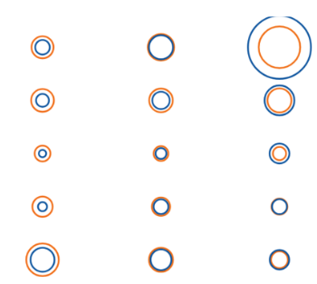
Client distribution by length of relationship and revenue
Table 1
Client revenue Quintile | Average of distinct number of product subcategories | Average of distinct number of product categories | Margin
Number of clients and revenue and percentage variance with the same period for the previous YTD. Also, should show the percentage of clients and revenue and percentage point difference with the same period for the previous YTD.
Table 2
Revenue quintile
Length of relationship Quintile | Average of distinct number of product subcategories | Average of distinct number of product categories | Margin
Length of relationship quintile
Table 1a
Table 2a
Client revenue Quintile | Category 1 | Category 2 | Category N
 | Revenue and margin. Percentage difference YTD previous year | Revenue and margin. Percentage difference YTD previous year | Revenue and margin. Percentage difference YTD previous year
Length of relationship Quintile | Category 1 | Category 2 | Category N
 | Revenue and margin. Percentage difference YTD previous year | Revenue and margin. Percentage difference YTD previous year | Revenue and margin. Percentage difference YTD previous year

Slide 7
Achieved revenue vs Target revenue
2

Slide 8
Achieved revenue vs Target revenue
Investigate achieved revenue against target revenue (defined as 10% increase of the revenue of all customers in previous fiscal year)
Available filters Fiscal Year, Month
Population All clients YTD since the selection of the month and year.
Core chart
Bullet chart that shows progression on percentage achieved YTD against the target for the length of relation and value quintiles from the previous page.
Table 1
Table of Lost Clients (defined as clients in previous fiscal year not in current fiscal YTD)
Rows: Length of relation and revenue quintiles
Columns: Product category
Values:
1) Number of clients, revenue, and margin on previous fiscal year
2) Total revenue and margin on all years
Table 2
Table of New Clients (defined as clients YTD not in previous fiscal years)
Rows: Product category
Values:
1) Number of clients, revenue, and sales margin
2) Percentage variance of new clients for the same period previous year on number of clients, revenue and margin

Slide 9
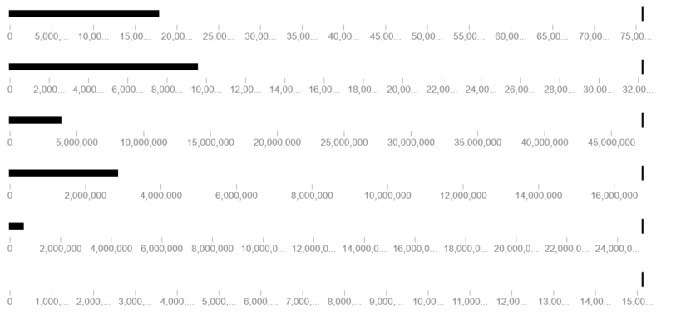
Achieved revenue vs Target revenue - expected output
Revenue and Length of relation Quintiles
Table 1: Lost clients - 5 columns per category
Table 2: New clients
Revenue and length of relation quintiles |  | Category 1 | Category 2 | Category N
 |  | Number of clients, revenue, and margin on previous fiscal year Total Revenue and margin for all years | Number of clients, revenue, and margin on previous fiscal year Total Revenue and margin for all years | Number of clients, revenue, and margin on previous fiscal year Total Revenue and margin for all years
Rev 1 | Length 1
 | Length 2
 | Length …
Rev 2 | Length 1
Product Category | Number of clients | Revenue | Sales margin | Percentage variance of new clients for the same period previous year on number of clients | Percentage variance of new clients for the same period previous year on number of revenue | Percentage variance of new clients for the same period previous year on number of margin
Category 1
Category 2
Category 3
Category …

Slide 10
Ordered Revenue and Sales Margin
3

Slide 11
Ordered Revenue and Sales Margin
Investigate of the revenue and margin over the last 12 months of the selected population
Available filters Fiscal Year, Month
Population Previous 12 month revenue for the clients in the selected month and year.
Core chart
Line chart
Y axis: Cumulative revenue and margin, both ordered by margin in descending order (highest margin to lower margin) of the
clients that had revenue in the last 12 months of the selected Fiscal Year and Month.
X axis: Percentage of the population selected
Card: Upon selection of an area on chart, average number of distinct product subcategories, revenue, and margin
Table
Rows: Client revenue and length of relationship quintile
Values: prior 12 month revenue, margin, and percentage differences with previous 12-24 months clients

Slide 12
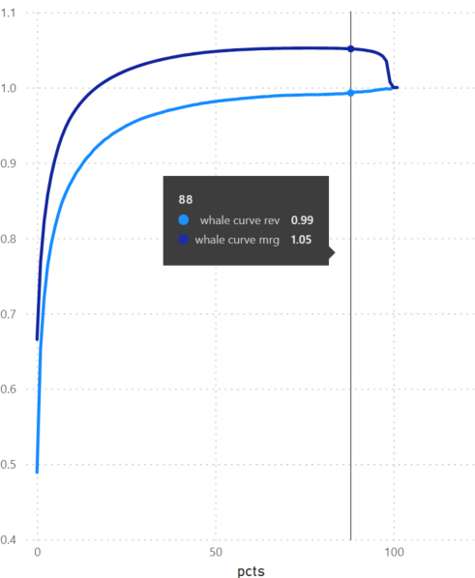
Ordered Revenue and Sales Margin - expected output
average number of distinct product subcategories, revenue, and margin of selected area
Revenue and length of relation quintiles |  | Previous 12 month Revenue and % difference 12-24 months | Previous 12 month Maring and % difference 12-24 months
Rev 1 | Length 1
 | Length 2
 | Length …
Rev 2 | Length 1

Slide 13
Revenue trend
4

Slide 14
Revenue trend
Investigate how clients increase or decrease their revenue over time.
Revenue growth is evaluated as CAGR on a linear regression fitted on the normalized values of the revenue over a period of the months selected. Values are normalized as percentage of revenue by month over the number of months selected.
CAGR is the compound annual growth rate with the formula defined as:
((value at end of period/value at the beginning of period) ^ (1/(number of periods – 1)) – 1
Available filters Fiscal Year, Month and number of months to evaluate revenue growth
Population Clients in the selected month and year.
Core chart
Bar chart
X axis: Revenue growth banded in 10 bands. (Bands 10 to 6 are CAGR greater than 0 and bands 5 to 1 lower than 0)
Y axis: Number of clients and revenue.
Card: Number of clients and revenue that have less months that the span selected

Slide 15
Revenue trend
Bonus chart 1 (table)
Rows: Client value and Length of relationship quintile
Columns: Revenue growth bands
Values: Growth percentage point difference with the population on previous x months selected
e.g. growth period = 6 months, current selection is FY = 2024 month = 10, then the populations to compare are in green (6 months to current selection), and in blue (6 months prior to that)
 | FY | Month
 | 2023 | 9
 | 2023 | 10
 | 2023 | 11
 | 2023 | 12
 | 2024 | 1
 | 2024 | 2
 | 2024 | 3
 | 2024 | 4
 | 2024 | 5
 | 2024 | 6
 | 2024 | 7
 | 2024 | 8
 | 2024 | 9
Current Selection - > | 2024 | 10
 | 2024 | 11
 | 2024 | 12

Slide 16
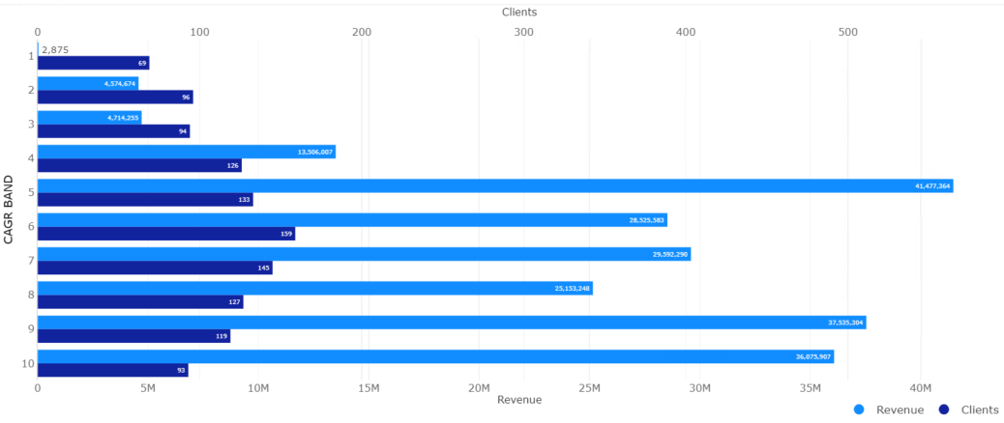
Revenue trend - expected output
Number of clients and revenue that have less months that the span selected
Revenue and length of relation quintiles |  | Ppt difference population x months before
Rev 1 | Length 1
 | Length 2
 | Length …
Rev 2 | Length 1

